Slide 1
Data Quality Review – The Annual Report
Data Quality online

Slide 2
Outline – Data Quality Report
Annual report using WHO DQ Tool
(Has your country installed it and customised it?
Who is responsible for the customisation?)
Purpose of this report – who needs this and why do they need it?
Actions taken – result in demonstrable changes?
Reviewing the (actual) data and making corrections
Checking for outliers and obvious data errors and correcting
Check for missing months of data and ‘filling’ them in

Slide 3
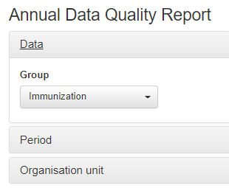
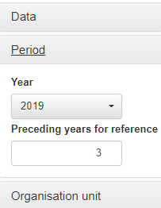
Annual report using WHO DQ Tool

Slide 4
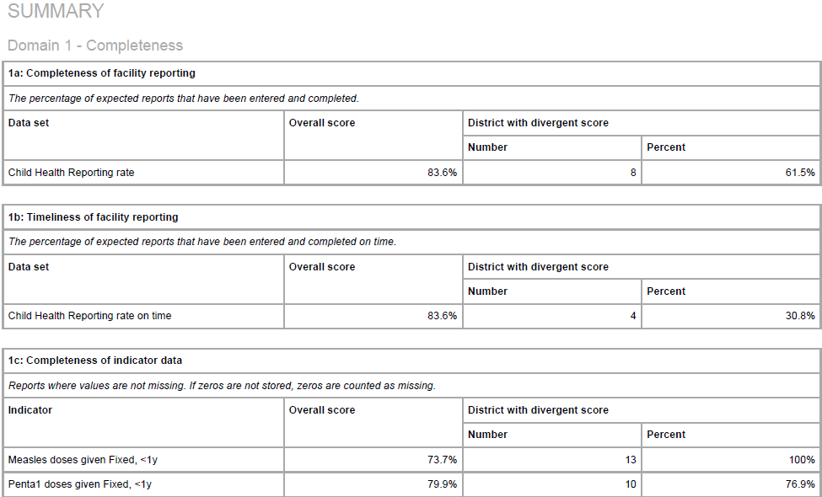
Annual Report - output

Slide 5
Annual Report – now what?
Is this report helpful?
If so – for who?
What guidance does this report provide?
It is a guarantee that the data is correct, complete, consistent and timely?

Slide 6
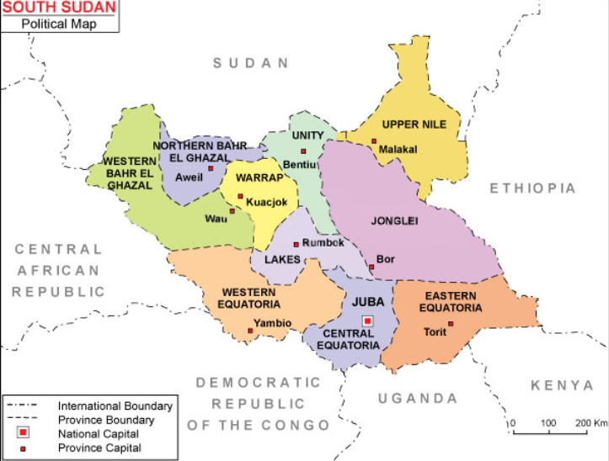

Data Quality Review/data cleaning in South Sudan
Data review and cleaning done in South Sudan (using DHIS1.4)
Done for 2012/2013/2014 data

Slide 7
Why bother to clean data?
Poor quality data is generally not usable
all that effort for no return
A few obvious data entry errors can be viewed as a sign that all the data is untrustworthy
Correcting obvious errors makes the data usable and acceptable
In spite of validation checks and quarterly reviews – data errors will creep in and frequently remain undetected/uncorrected
South Sudan using DHIS1.4 at the time of the data cleaning process

Slide 8
Background in South Sudan
HMIS/ Minimum Indicator based dataset implemented in 2011 with 2 pages
Decision made in 2013 to clean the data for report for 2012 Annual Report
Done at state level (10 states) with some states combined for convenience
Present was the State M&E Officer, and the County M&E Officer for each county – and they took the responsibility for correcting the data
Took some 4-5 days per group of States – labour intensive process

Slide 9
Process 1
Decision made to concentrate on crucial data elements
Headcount
Children with diarrhoea/pneumonia/malaria
Maternal health – ANC visits/deliveries/live births
Validation rules (absolute and statistical) were run and noted (same as DHIS2)
Extreme outliers identified and corrected using tools in DHIS1.4 (Interpolation/regression analysis)

Slide 10
Process 2
Concentrate on replacing missing months of data (i.e. missing for the whole month using interpolation)
Validation rules that revealed missing compulsory pairing were resolved
Diarrhoea treated must have diarrhoea reported
Look for extreme outliers and correct those at facility level, specifically if this value materially altered the indicator value
Reviewed both raw data and indicators

Slide 11
Actions
Decision tree for Data outliers
Re-calculate using regression
Data out of range or errors
Services were not provided by the HF
Data out of range or errors
Data out of range or errors
DELETE
Services provided
Services provided
Report data elements do not hang together
Report data elements hang together
Re-calculate KEY data elements and provide comment

Slide 12
Actions
Decision tree for Missing Data
Close facility in database
Missing data
Services were provided by the HF
Missing data
Missing Data
CORRECT/INTERPOLATE
Services not provided because facility has closed
Services not provided
Write ZERO (0) and comment

Slide 13
How was this possible?
SMALL dataset
Eagerness of local staff to take responsibility and fix own data
Pride in clean data with no violations
Hands on support and supervision

Slide 14
Results
Cleaned data for 3 years resulting in an annual report for each year
Able to measure service delivery over time
Staff with more capacity and knowledge of HMIS/DHIS
Updated facility list

Slide 15
Conclusion
Has all the missing data (where you KNOW a facility worked but there is no report) been added in
Are all your outliers fixed
Have all validation rules been fixed or explained
WHO takes responsibility for this??
Is it important?

Slide 16
Exercise: WHO Annual Report
Using either your own DHIS2 instance or the demo data file
Run the WHO Annual report for a selected OU and DE/Indicator Group
Print – which will allow you to download in .pdf format
Review and discuss : How can you use this report?

Slide 17
Exercise: Data review and corrections
Using your own DHIS2 instance or the Demo instance
Using the WHO DQ tool – find missing data and outliers
What needs to happen to replace the missing values or correct the obvious data outliers
How will you decide what the new value should be?

